Slide 1
The Diameter of Hanoi Graphs
Information Processing Letters 98(2006) 79-85
Daniel Berend , Amir Sapir
Presenter: Jun-Shong Lin
Date: May 25, 2006

Slide 2
Abstract
Many questions regarding the Tower of Hanoi problem have been posed and answered during the years. Variants of the classical puzzle, such as allowing more than 3 pegs ,and imposing limitations on the possible moves among the pegs, raised the analogous questions for those variants. One such question is: given a variant ,and a certain number of disks, find a pair of disk arrangements such that the minimal number of moves required for changing from the first to the second is maximal over all pairs.

Slide 3
Abstract (cont.)
One of the main results of the paper is identifying these for the Cyclic_{h} variants—the variants with h pegs arranged along a uni-directional circle—to be the pairs of perfect configurations where the destination peg is right before the source peg.

Slide 4
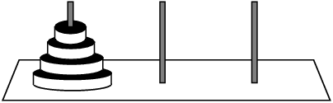

Introduction
The Tower of Hanoi puzzle:

Slide 5
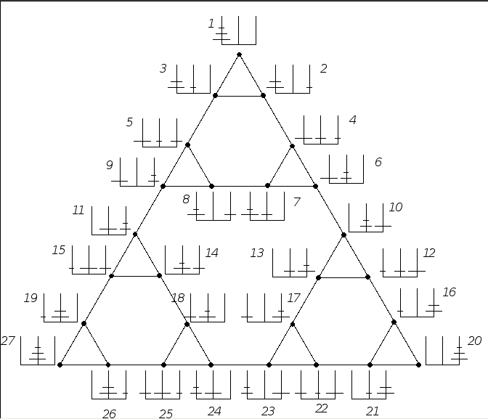
Introduction
Question 1. Find a pair of disk arrangements (henceforth configurations) requiring the longest sequence of moves in order to get from one to the other.
Hanoi Graph

Slide 6
Introduction
Perfect Configuration -> Perfect Configuration :
1 2 3
1 2 3
Not Perfect Configuration -> Not Perfect Configuration :
1 2 3
1 2 3

Slide 7
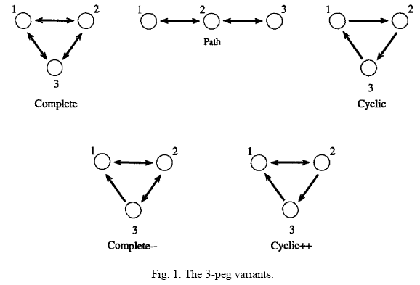
Introduction
Variant Graphs:

Slide 8
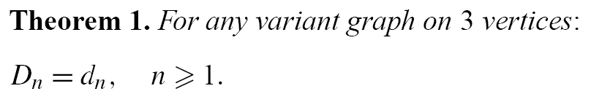
The Main Results
What can be said for general graphs about the relation between D_{n} and d_{n}?
Clearly, d_{n} ≤ D_{n}.
So we will focus on proving that d_{n} ≥ D_{n}.

Slide 9
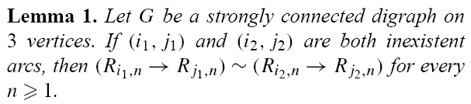
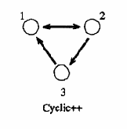
The Main Results
Inexistent arc
i₁ j₁
i₁ j₁
||
i₂ j₂
i₂ j₂

Slide 10
The Main Results
d_{n} ≥ D_{n} ?
<1>Algorithm 1. move3pegs(C,C’,n).
<2>The restricted algorithm.
Prove that the sequence of moves produced by Algorithm 1 for any task whatsoever is not longer than the one produced by the restricted algorithm, when the task is to move a tower with the same number of disks over an inexistent arc.

Slide 11
The Main Results
Case I: Disk n resides on the same peg in both C and C’.
Case II: In C disk n resides on peg i and in C on peg j , where (i, j) is an arc
1 2 3
1 2 3
Reduce the problem to one of moving n -1 disks!
i j
i j
i j
i j
Auxiliary Peg

Slide 12

The Main Results
…...
?
?
…...
i j
i j
i j
Auxiliary Peg
Auxiliary Peg
Auxiliary Peg

Slide 13
The Main Results
We proceed by induction. For n = 0, our claim is trivial. Suppose it holds for configurations of n − 1 disks for some n ≥ 1,and let C, C’ be configurations on n disks.
There are two possibilities to examine, in accordance with Cases II and III above.
(Case I is trivial.)

Slide 14
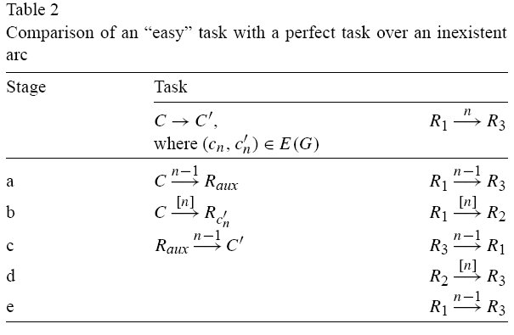
The Main Results
Case II :
≦
=
≦

Slide 15
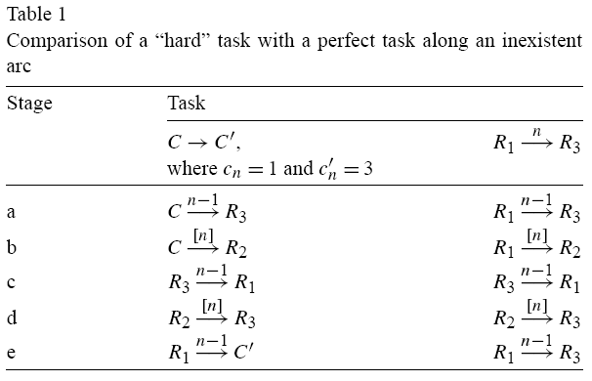
The Main Results
Case III :
≦
=
=
=
≦

Slide 16
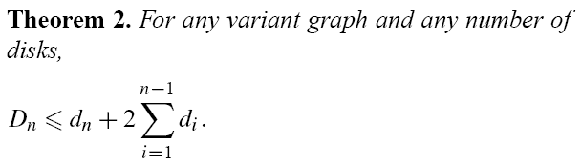
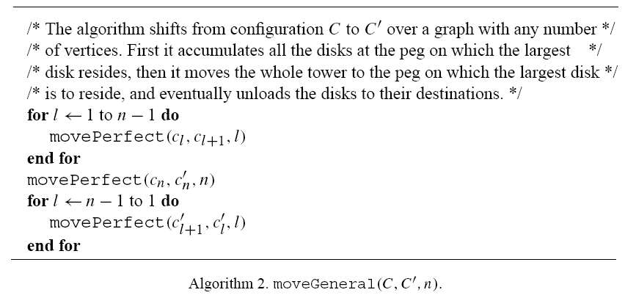

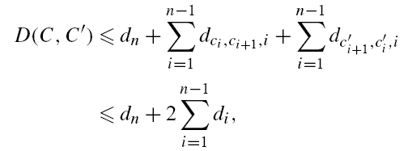
The Main Results

Slide 17
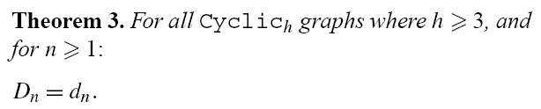
The Main Results
1
h
2
3
h-1

Slide 18

The Main Results
d_{n} ≥ D_{n} ?
1 2 3 h
1 2 3 h
≦
……..
……..
1 2 3 h
1 2 3 h
≦
≦………
……..
……..

Slide 19



The Main Results
1
h
2
h-1
3

